Slide 1
Understanding Multicollinearity in Linear Regression:
Good or Bad?

Slide 2
Understanding Multicollinearity in Linear Regression
In linear regression, we often check how well independent variables (predictors) explain the dependent variable (target).
But what happens when two independent variables are highly correlated with each other?
Is it a problem?
Let’s break it down!

Slide 3
What is Good for a Model?
When independent variables (X1, X2, ...) have a strong correlation with the dependent variable (Y), it means they provide useful information for prediction.
This improves the model's predictive power.

Slide 4
What Causes Problems? (Multicollinearity)
If two independent variables (X1 and X2) are highly correlated with each other, it leads to multicollinearity, which can cause: 🔹 Unstable Coefficients: The model struggles to decide the contribution of each variable. 🔹 High Variance in Estimates: Small changes in data can lead to big changes in regression coefficients. 🔹 Difficult Interpretation: Hard to determine which predictor is more important.

Slide 5
How to Detect Multicollinearity?
Check Correlation Matrix:
If two independent variables have r > 0.7, multicollinearity might exist.
Variance Inflation Factor (VIF):
A VIF > 5 or 10 signals multicollinearity.
Drop One Variable If Needed:
If two independent variables are highly correlated and provide similar information, consider removing one.

Slide 6
General Rule:
Good: Strong correlation between independent variables and the dependent variable (Y) (this improves the model).
❌ Bad: Strong correlation between independent variables (this creates multicollinearity issues).

Slide 7
Key Takeaway:
Predictors should be correlated with the target but not too much with each other!
Check for multicollinearity and take action if necessary.

Slide 8
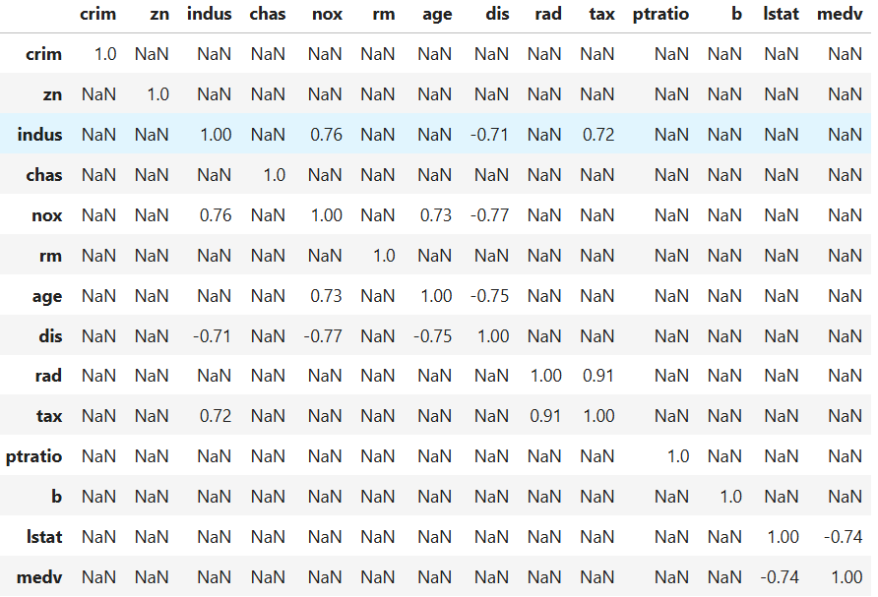
Example to detect Multi collinearity

Slide 9
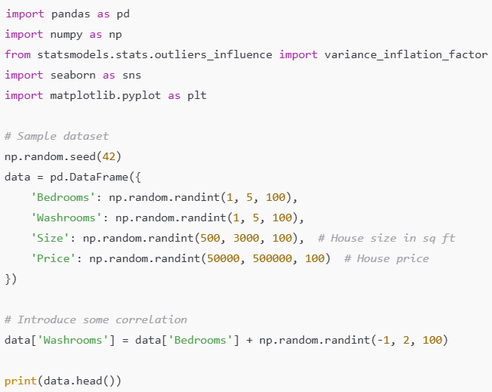
Step 1: Create Sample Data

Slide 10
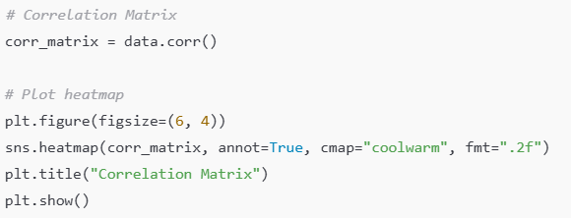
Step 2: Check Correlation Matrix
If Bedrooms and Washrooms show high correlation (r > 0.7), multicollinearity might exist.

Slide 11
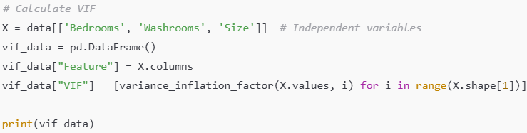
Step 3: Calculate Variance Inflation Factor (VIF)
Interpretation of VIF Results
VIF > 5 or 10: High multicollinearity → Consider removing the variable.
VIF < 5: No serious multicollinearity → Keep the variable.
If Bedrooms and Washrooms have high correlation and high VIF, one of them can be removed.
If removing one reduces VIF and doesn't hurt Adjusted R², it's a good choice.
Always check model performance before removing features.

